Slide 1

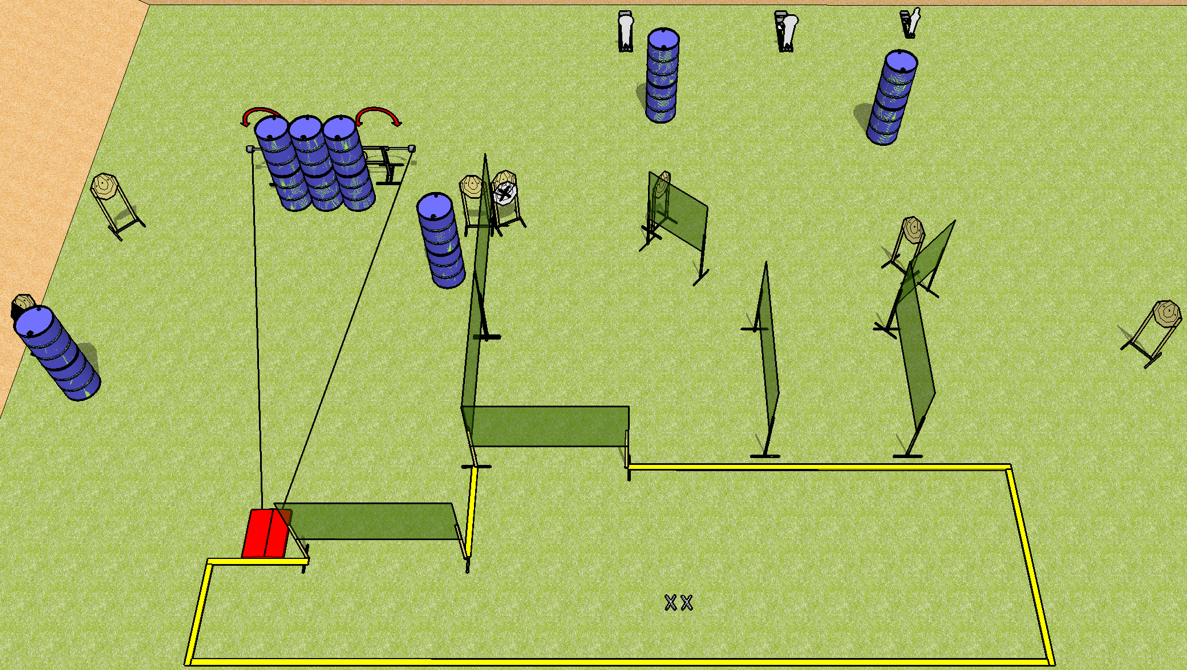
 | Dothan Practical Shooters – USPSA Match Daddy Wasn’t There Course Designer : Drew Coleman Bay: B4
Round Count 30 rounds 9 IPSC 2 colt, 1 mini
Equipment List 2 swingers + stomp pad 14 wall feet 1 left diag 9 targets (8 + 1 NS)

Slide 2
Daddy Wasn’t There
Written Stage Briefing
Scoring: Comstock Rounds: 30
Targets: 9 IPSC, 3 steel
Handgun start position: feet on X’s, wrists below belt. Handgun is loaded and holstered.
PCC start position: feet on X’s, stock on belt. Loaded carbine is held with both hands, safety on.
Stage Procedure: on the audible start signal, engage targets as they become available from within the shooting area. The stomp pad activates the swingers, which remain visible at rest.

